Slide 1



Antibody-Based Therapeutics for Treating Alzheimer’s and Parkinson’s Diseases
Taylor Brownlee
Dr. Michael Sierks
Chemical Engineering
2012 Arizona/NASA Space Grant Symposium
University of Arizona
April 21, 2012

Slide 2
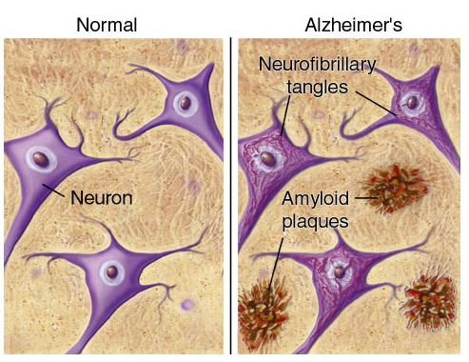
What Causes Alzheimer’s and Parkinson’s Diseases?
2
Alzheimer’s disease (AD) and Parkinson’s disease (PD) are devastating neurodegenerative diseases
Plaques and tangles (AD) or Lewy bodies (PD)
Accumulate in different areas of the brain
Block nerve cell communication and cause cell death
Presence of plaques and tangles or Lewy
bodies is not a definitive
diagnosis for AD or PD
http://www.ahaf.org/alzheimers/

Slide 3
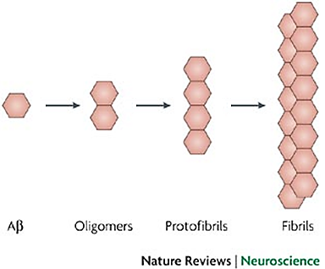
Research Objectives
Process of protein misfolding and accumulation causes disease
β-amyloid and α-synuclein are two biomarkers (proteins) linked to AD and PD
Oligomeric forms of β-amyloid and α-synuclein are the key toxic species
Identify antibodies to detect
β-amyloid and α-synuclein
Can be used for therapeutics and diagnostics

Slide 4
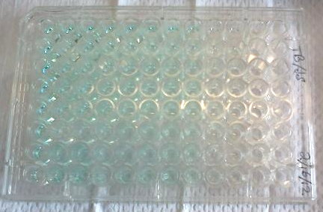
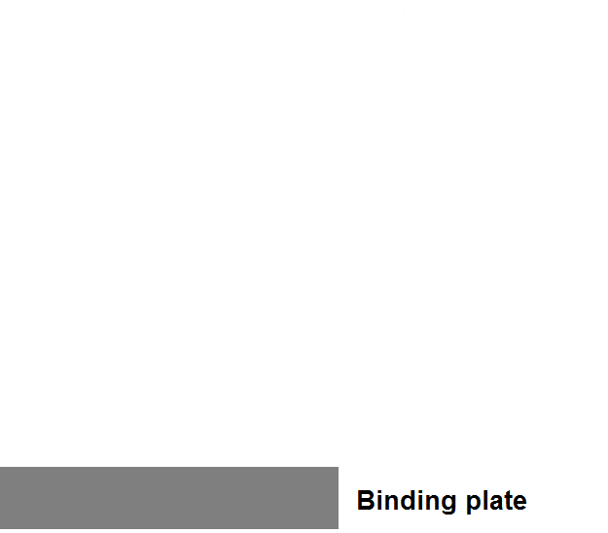
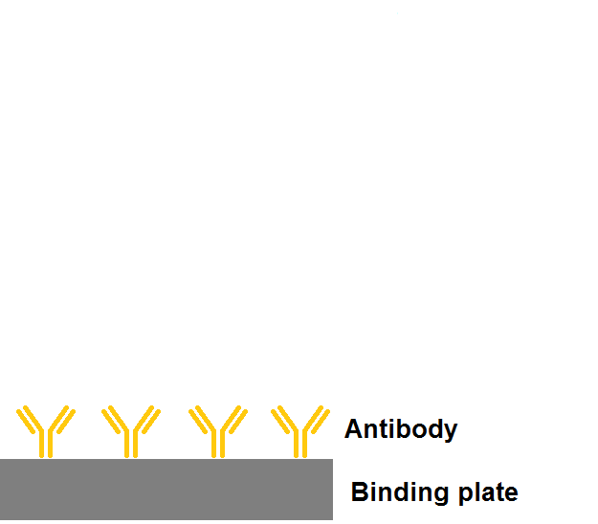
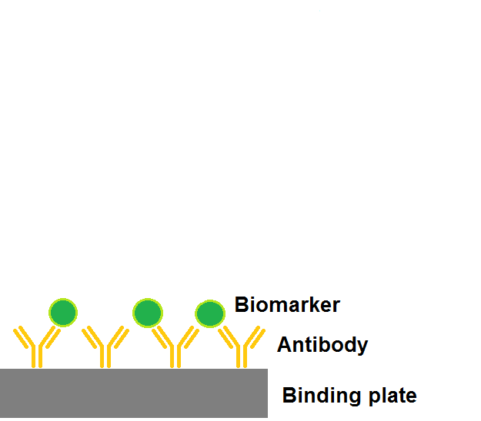
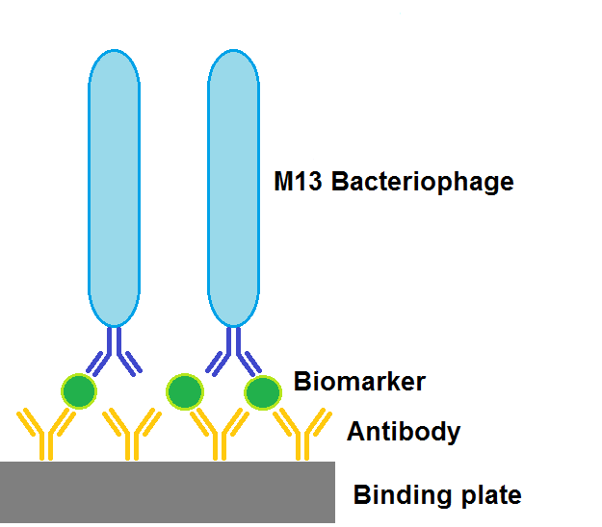
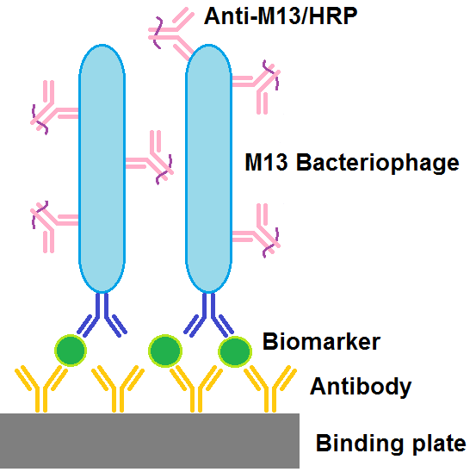

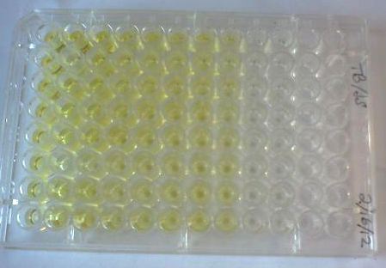
Sandwich ELISA

Slide 5
Results for PD Antibody

Slide 6
Conclusions
Process of protein misfolding and accumulation causes Alzheimer’s and Parkinson’s diseases
Antibodies detect toxic biomarker species that cause AD and PD
Sandwich ELISA detects the biomarker concentration
1E-07 M13 bacteriophage concentration yielded the largest biomarker signal
Further study must be done to perfect ELISA protocol

Slide 7

Thank you! Questions?

